Slide 1
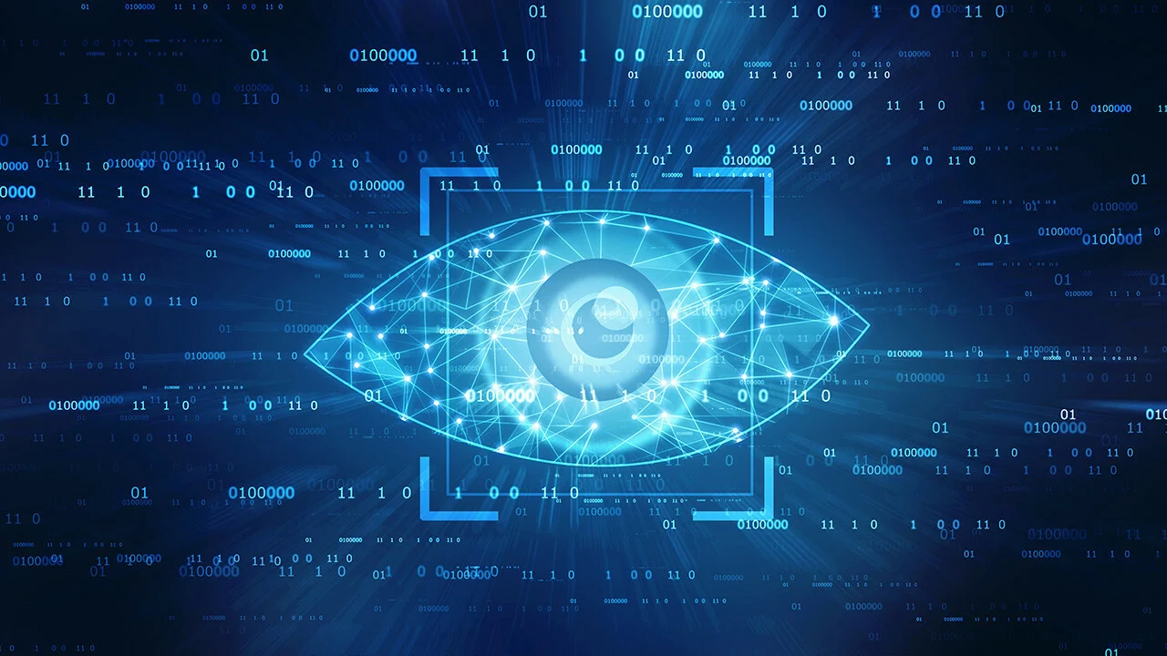
Malware Classification through Computer Vision
Prasann Viswanathan Iyer
190070047

Slide 2
Introduction
Static Malware classification - without executing the programme
Signature matching - Standard Method but with limitations
Obfuscations in code
Exponentially growing number of signatures
Machine Learning Approaches are more robust and scalable
Feature Construction issues
Disassembly step
Binning the types of function calls, counting loops
Large Feature space requires reduction with PCA or K-PCA
Aim is to consider Malware Classification as a Computer Vision problem

Slide 3
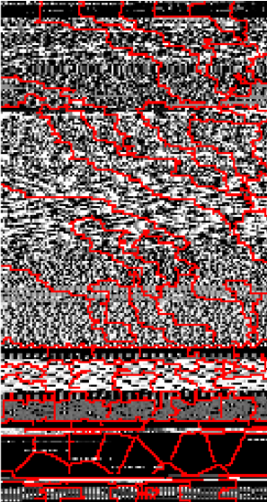
Methodology
Convert Byte Code of Malware to images
Map Binary Code to integers in [0,255]
Convert to 2D image with dimensions based on size of Malware file
Apply Transfer Learning via existing Deep Image Neural Networks
Inception
ResNet
VGG
DenseNet
Classic feature construction method and image method to Decision Forest
Compare the classification performance

Slide 4
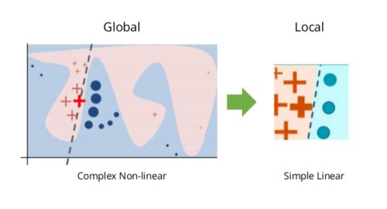
Evaluation and Interpretation
Classification Metrics
Accuracy
True Positive Rate
False Positive Rate
F1 score
Local Interpretable Model-Agnostic explanation algorithm
To understand the reason for our models prediction
Conclude whether conversion to images assists in Malware Classification
With respect to both Classification Metrics and Model Performance Speed

Slide 5
Thank You

